Slide 1

Student Performance & Academic Insights Dashboard
Analyzing student performance, attendance, and learning factors
Name: Hetvi shah Enroll:2304030100505
Silver oak university

Slide 2

Problem
Statement
Schools often struggle to
identify why some students
perform better than others.
By analyzing academic scores,
attendance, and study habits,
this dashboard helps identify
key factors affecting student
success.

Slide 3
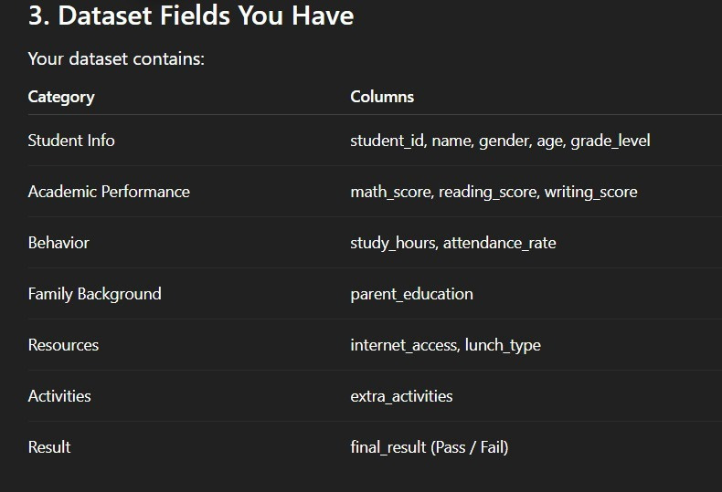
Dataset Fields You have :

Slide 4
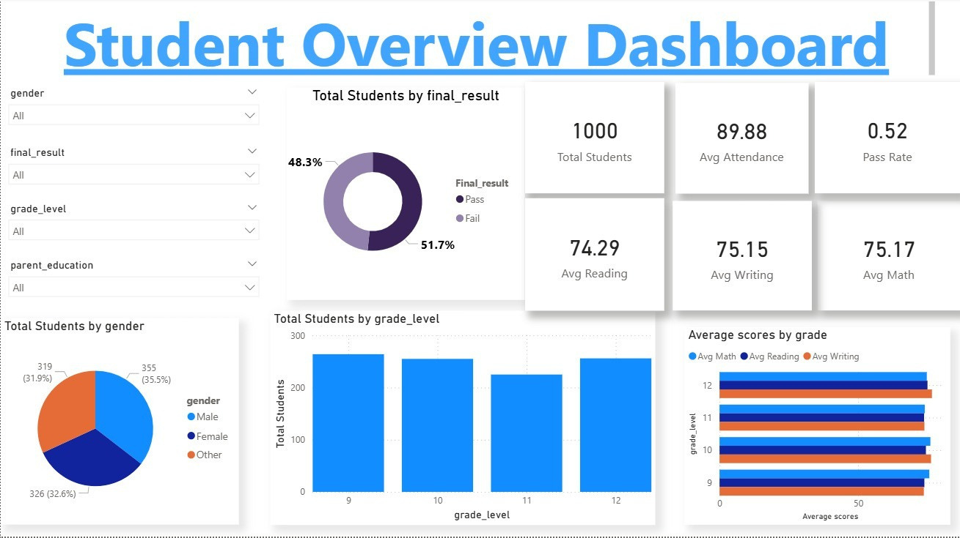

Slide 5

Some DAX Formulas:
Total Students:
Total Students = COUNT(student_info[student_id])
Average Math Score:
Avg Math = AVERAGE(student_info[math_score])
Average Attendance:
AvgAttendance =
AVERAGE(student_info[attendance_rate])
Pass Percentage :
Pass Rate =DIVIDE( CALCULATE(COUNT(student_info[final_result]), student_info[final_result]="Pass"), COUNT(student_ info[final_ result]))

Slide 6
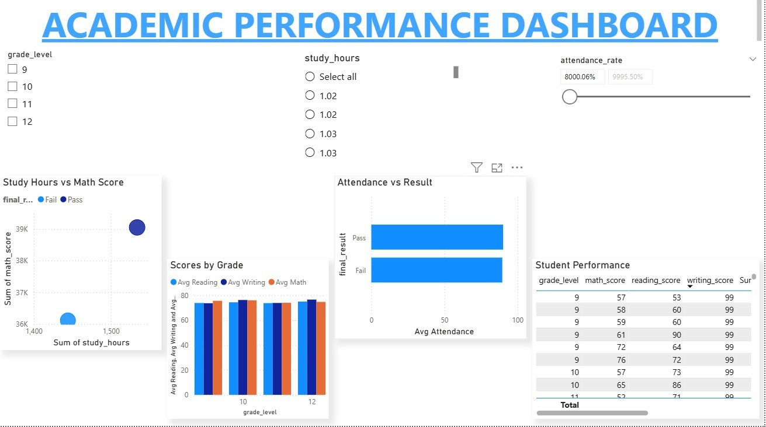

Slide 7
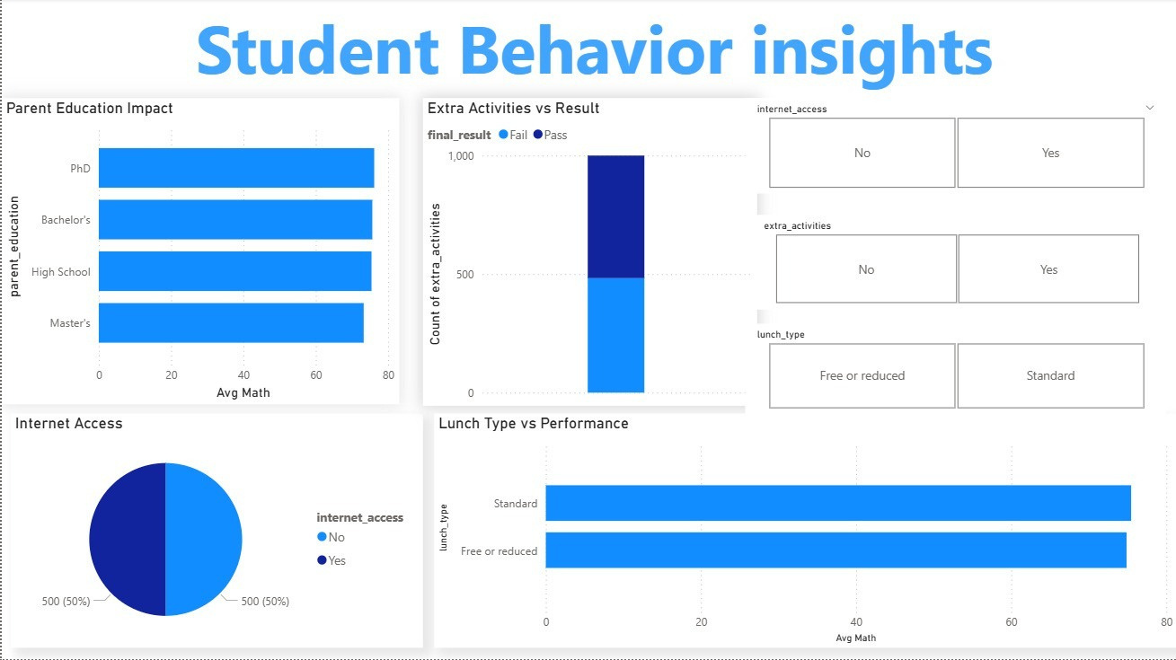

Slide 8

Key Insights from Dashboard
Key Insights from Education Analytics Dashboard
Study Hours vs Performance :
Students who study more than 3–4 hours daily achieve higher academic scores.
Scatter plot analysis shows a positive relationship between study hours and math scores.

Slide 9

2.Attendance Impact on Results :
Students with attendance above 85% perform significantly better.
Low attendance students show higher chances of failing
3.Internet Access Influence :
Students with internet access demonstrate slightly better academic performance
Access to online learning resources supports academic success.
4.Parent Education Effect :
Students whose parents have higher education levels tend to score better.
Family educational background positively influences learning outcomes.

Slide 10

5.Extra Activities and Engagement
Students participating in extra activities show better
engagement and balanced performance.
Activities may improve confidence, discipline,
and social skills.
6.Subject Performance Trends
Average scores show variation across subjects.
Some students perform better in reading and writing
compared to mathematics.

Slide 11

Conclusion
The Education Analytics dashboard provides valuable insights into student performance and learning behavior
Factors such as study hours, attendance, and
Series 1
Series 2
Series 3
access to resources significantly influence
academic results.
Item 1
Item 2
Interactive visualizations help identify patterns,
strengths, and areas for improvement.
Item 3
Item 4
0
10
20
30
40
50

Slide 12

The dashboardenablesdata-drivendecision-making
for educators and institutions
Such analytical tools can help identify
struggling students early and improve educational strategies.

Slide 13
Thynk Unlimited
THANK YOU
Unleash the Power of Data

